Slide 1
Obstacle Avoiding Robot
05/11/2025

Slide 2
Objective
The objective of this project is to construct an obstacle avoiding robot that can autonomously avoid obstacles (Without Human intervention).

Slide 3
Components
Arduino UNO board
L298N motor driver
HC-SR04 Ultrasonic Sensor
SG 90 Servo Motor
Motors with wheels
Battery pack, AA x 4 with on/off switch
Jumper wires

Slide 4
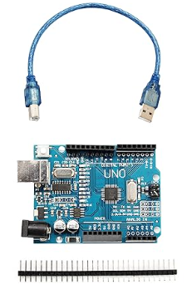
Components Description[1/7]
Arduino UNO board
Microcontroller board based on ATmega328P.
Acts as the brain of the system.
Processes sensor data and sends control signals to actuators (motors, servo).
Programmable via Arduino IDE.

Slide 5
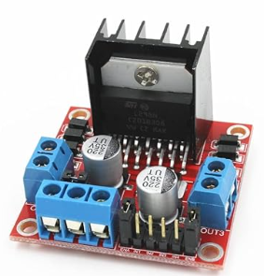
Components Description[2/7]
L298N motor driver
Dual H-Bridge motor driver IC.
Controls direction and speed of DC motors.
Receives control signals from Arduino.
Allow motor rotation (forward/backward) and speed control.

Slide 6
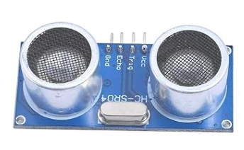
Components Description[3/7]
HC-SR04 Ultrasonic Sensor
Measures distance by emitting sound waves and measuring the time for them to return.
Used to detect obstacles in the robot's path.
Sends distance data to Arduino for obstacle avoidance.

Slide 7
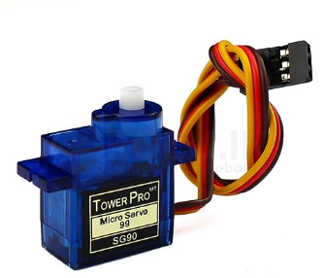
Components Description[4/7]
SG 90 Servo Motor
Small, lightweight servo motor.
Receives position signals from Arduino to rotate to a specific angle.
Used for steering or rotating components.

Slide 8
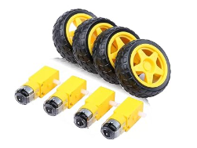
Components Description[5/7]
Motors with Wheels
DC motors with wheels attached.
Provides forward and backward movement.
Allows turning left or right.
Controlled by the L298N motor driver.

Slide 9
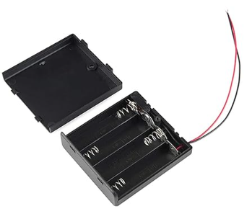
Components Description[6/7]
Battery Pack, AA x 4 with On/Off Switch
Powers the robot’s components.
4 AA batteries supply voltage.
On/Off switch controls the power flow.
Provides the necessary energy for motors and Arduino.

Slide 10
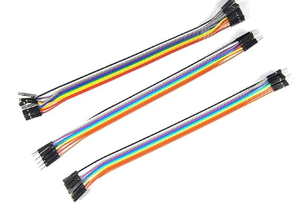
Components Description[7/7]
Jumper Wires
Used to make electrical connections between components.
Ensures proper circuit connections for functionality.

Slide 11
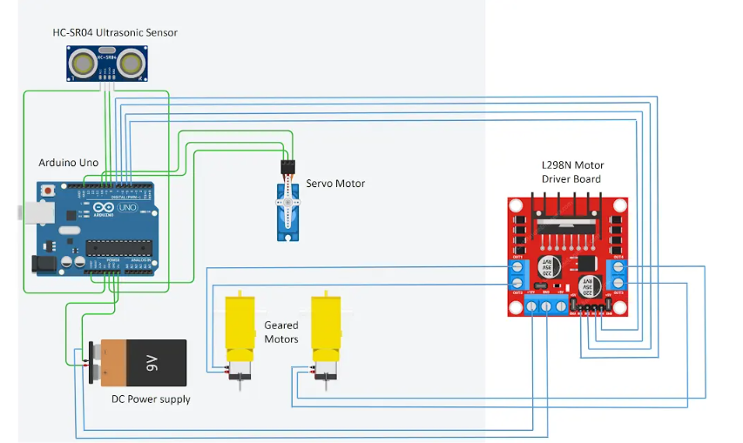
Circuit Diagram

Slide 12
Working[1/2]
Ultrasonic Sensor checks the distance to objects in front of the robot.
Arduino UNO processes this information and decides what to do.
If an obstacle is too close, the robot stops and turns to avoid it.

Slide 13
Working[2/2]
Motor Driver (L298N) controls the robot’s movement (forward, backward, turning).
The robot keeps checking for obstacles around it.
It moves and avoids obstacles automatically, without any human control.

Slide 14
Thanks For Listening Have a good day!!

